Slide 1
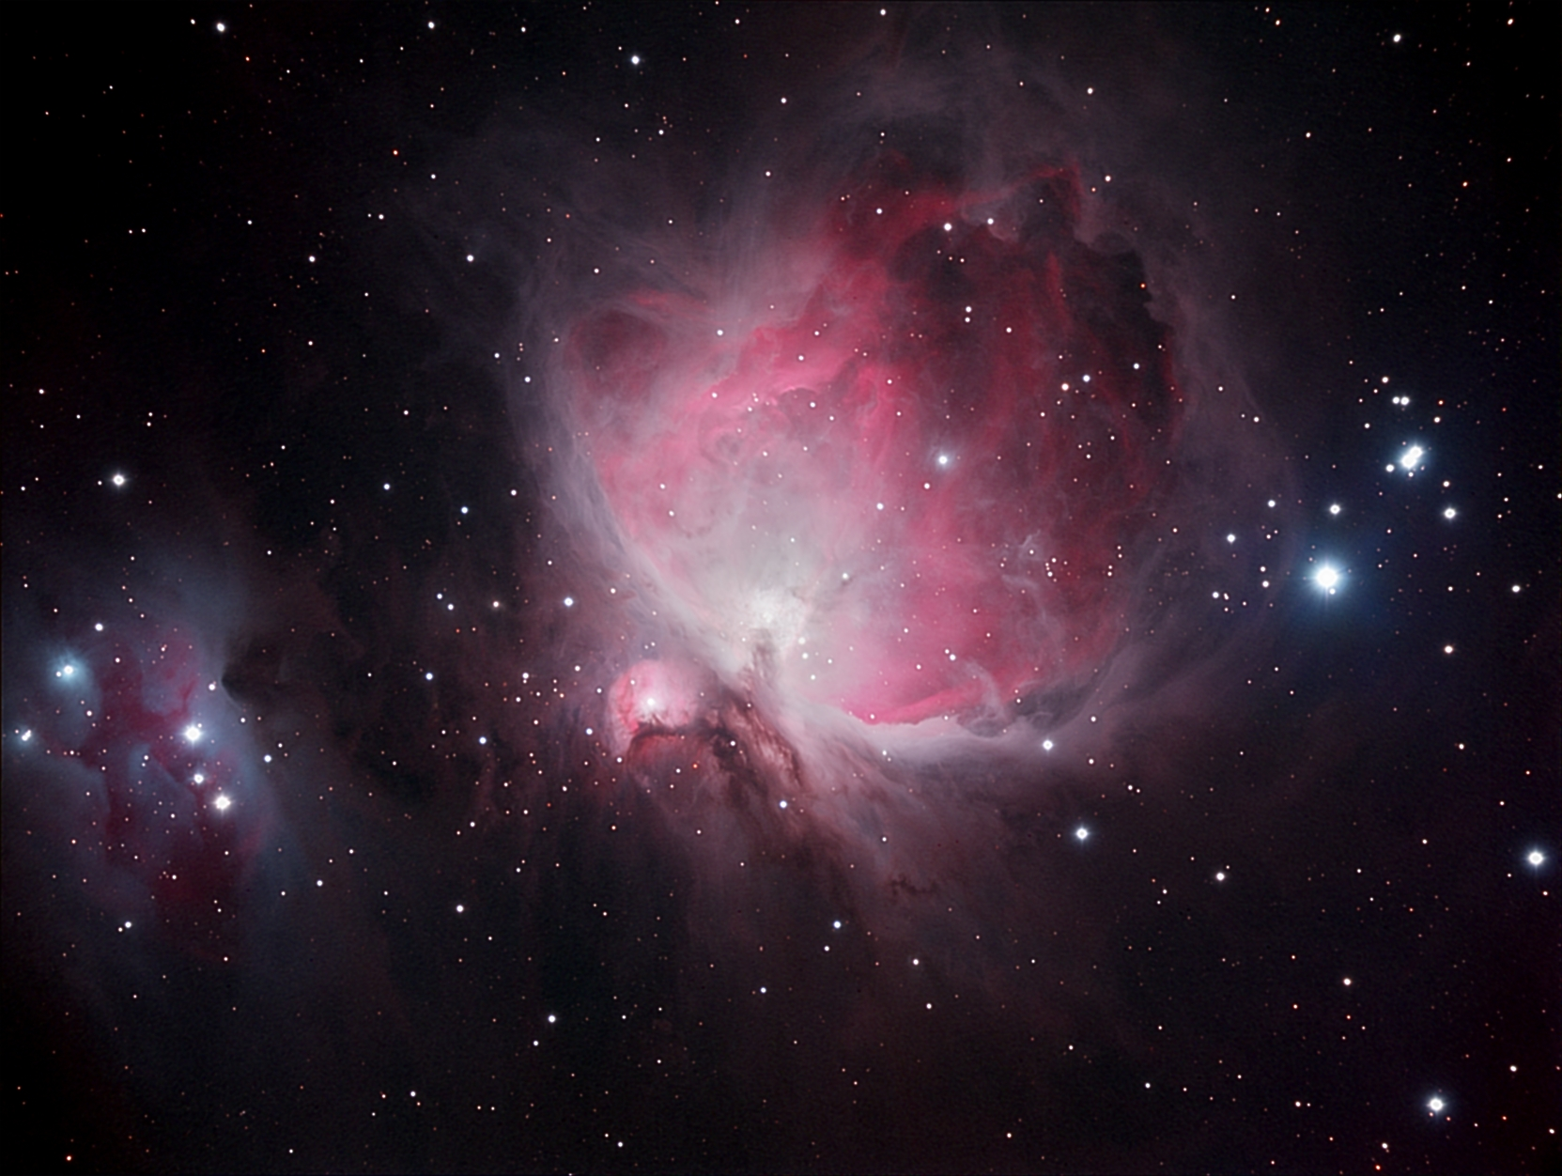
Orion Nebula
a bright diffuse emission nebula in Orion

Slide 2
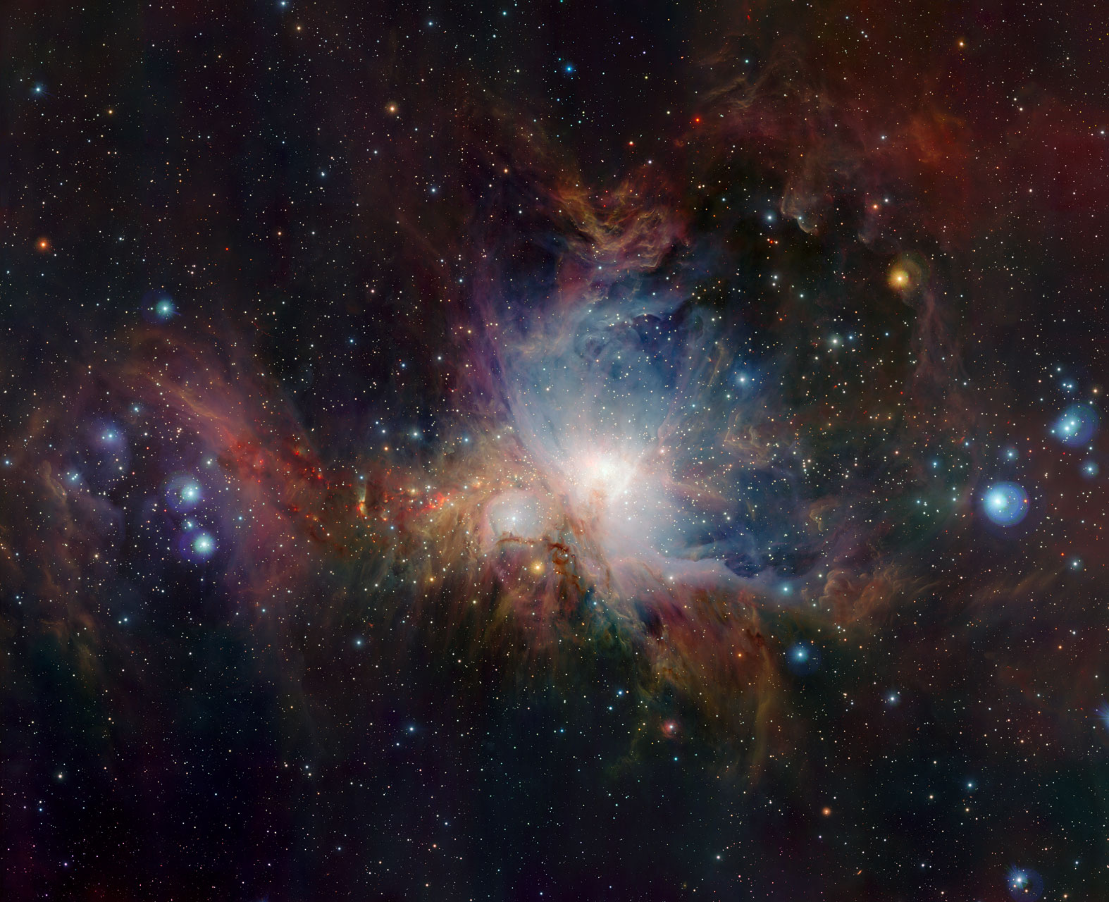
Orion Nebula
Visual Magnitude: + 4.0
(visible to the naked eye…but can’t really discern the nebulosity without binoculars
or a small telescope)
Apparent Size: 85 x 60 arcminutes

Slide 3
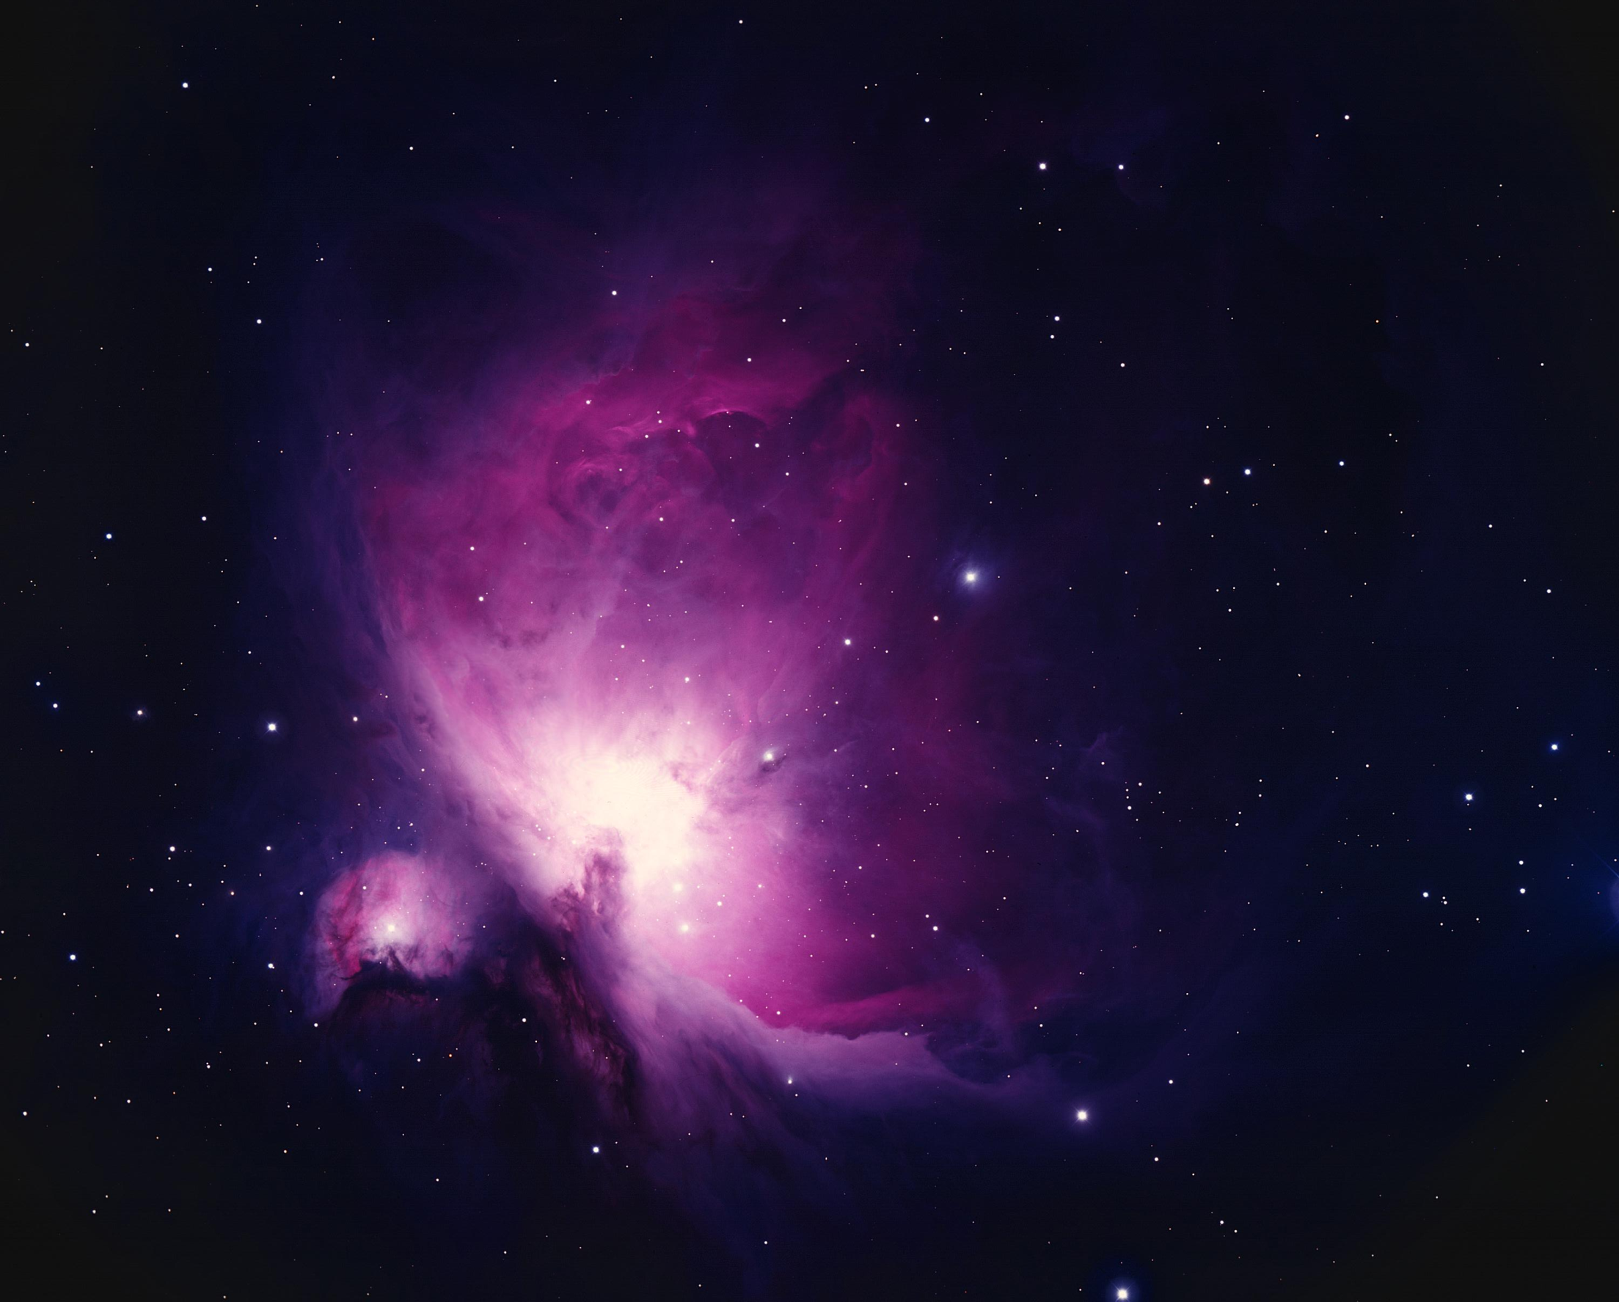
Orion Nebula
Distance: 1,350 light years away
Diameter: 24 light years across

Slide 4
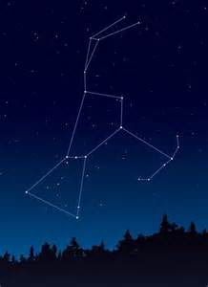
Orion Constellation
Betelgeuse
Nebula
Rigel

Slide 5
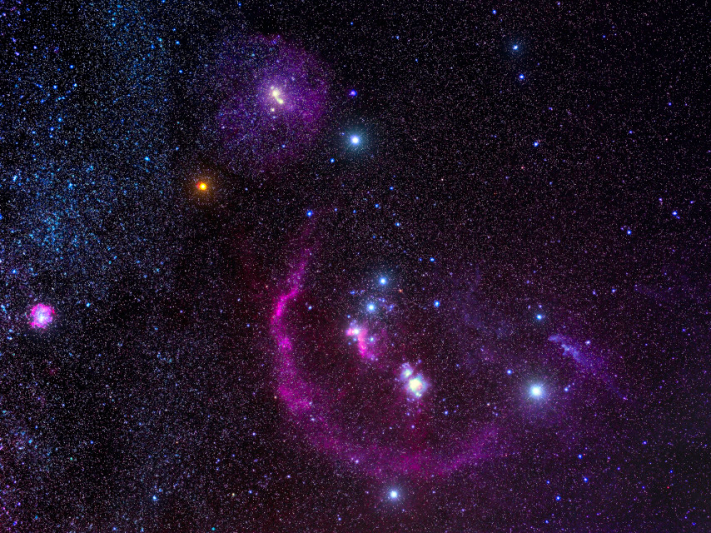
It is part of a much larger cloud of dust & gas called the Orion Molecular Cloud Complex.
Orion Nebula

Slide 6
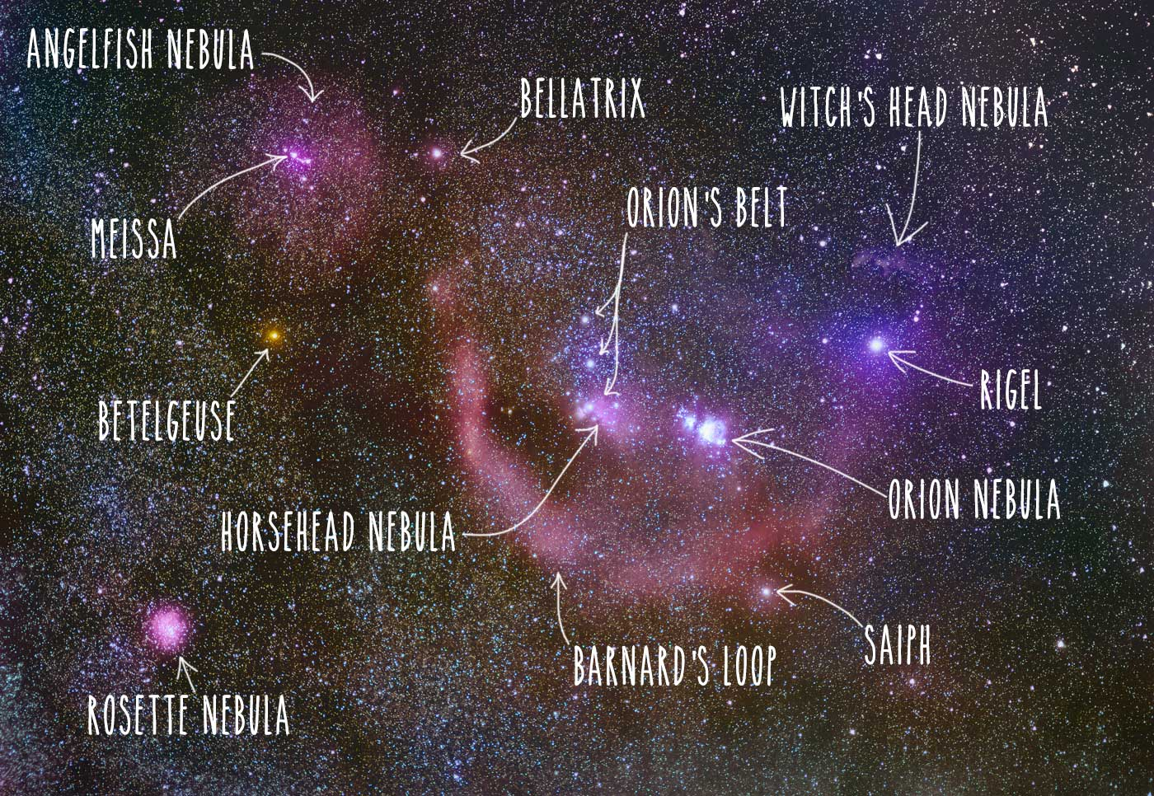
Orion Molecular Cloud Complex

Slide 7
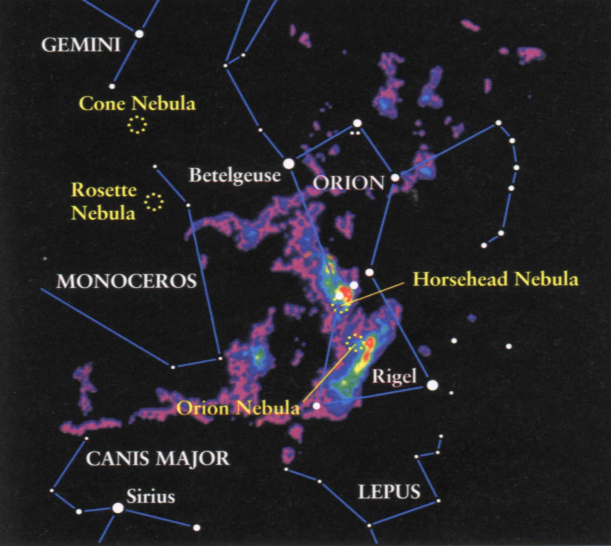
Orion Molecular Cloud Complex

Slide 8
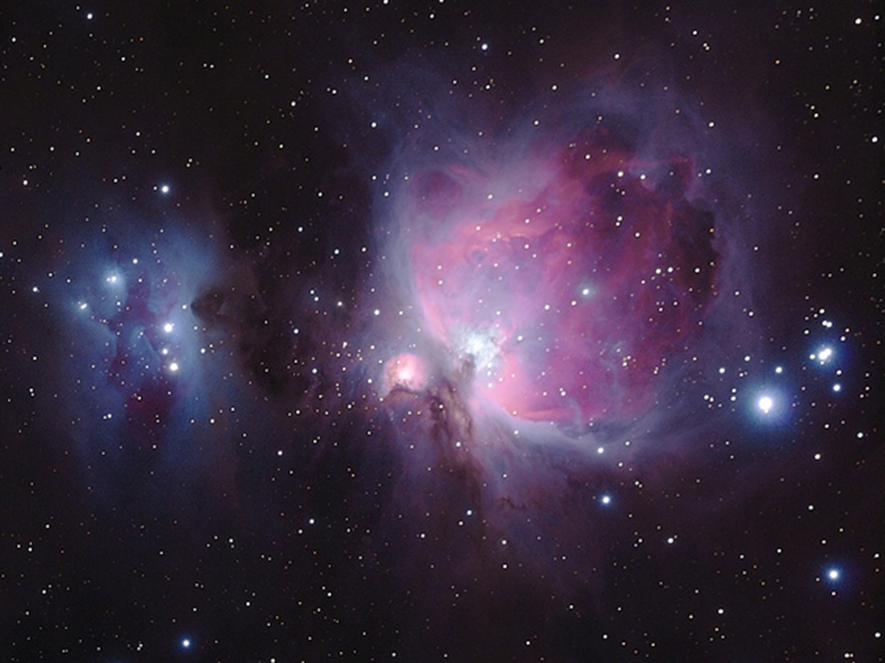
Orion Nebula History
In the early 1600s, Galileo detected faint stars and found this area to be a triple star system, but didn’t mention anything about nebulosity. This has led to speculation that the nebula’s illuminating stars have flared up since that time.

Slide 9
Orion Nebula History
Christian Huygens is credited with its discovery, whose sketch in 1656 was the first of it to be published.
Edmond Halley included it in his list of 6 nebulae in 1716.
Charles Messier first noted the nebula in 1769 and made it #42 on his list.

Slide 10
Orion Nebula History
In 1865, William Huggins studied it with spectroscopy and first revealed its gaseous nature.
In 1880, Henry Draper took the first photograph of the Orion Nebula through his 11-inch refractor, making it the first historical instance of deep-sky astrophotography.

Slide 11
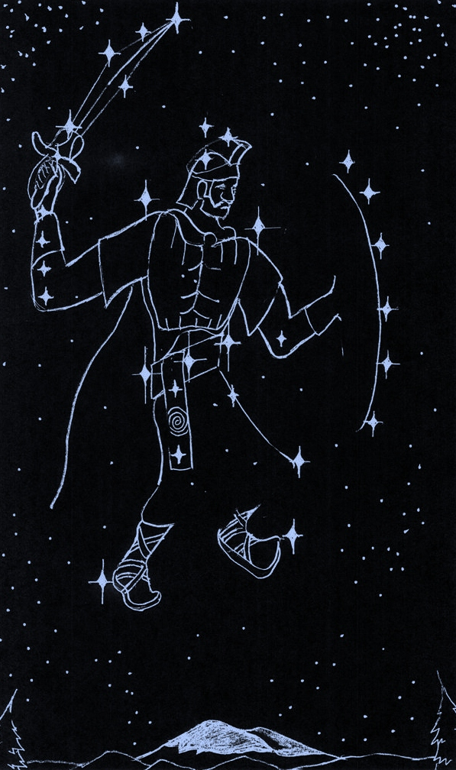
Orion Constellation
Betelgeuse
Nebula
Rigel

Slide 12
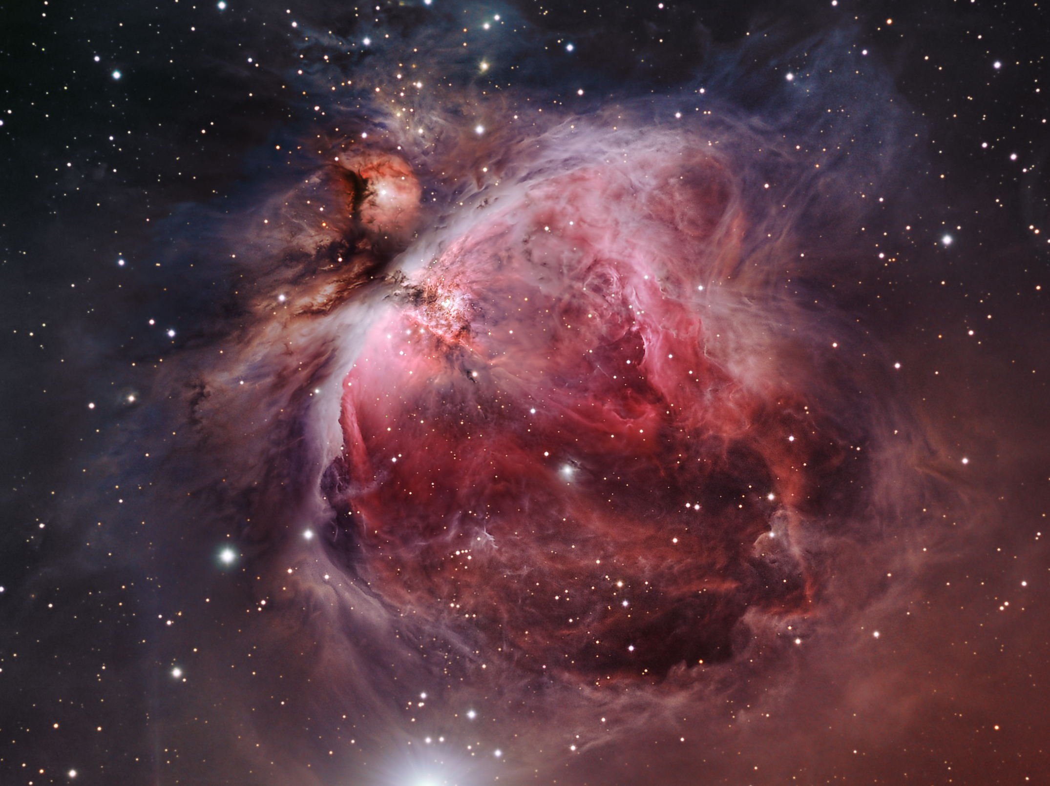
Orion Nebula
It is one of the most photographed objects in the sky.

Slide 13
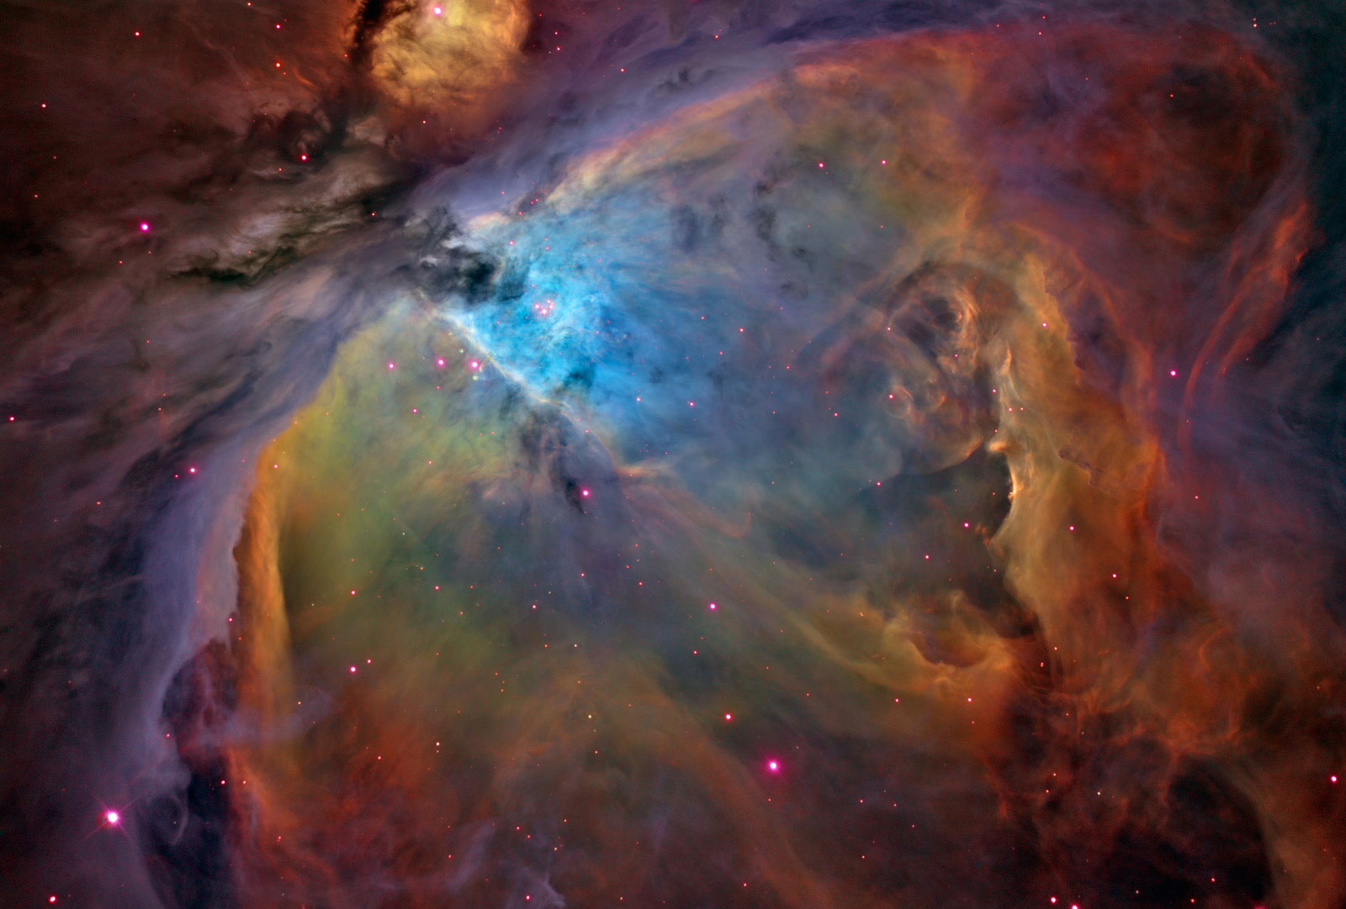
Orion Nebula
Red = ionized hydrogen
Blue/White = reflections from the stars off of dust particles
Green = doubly ionized oxygen

Slide 14
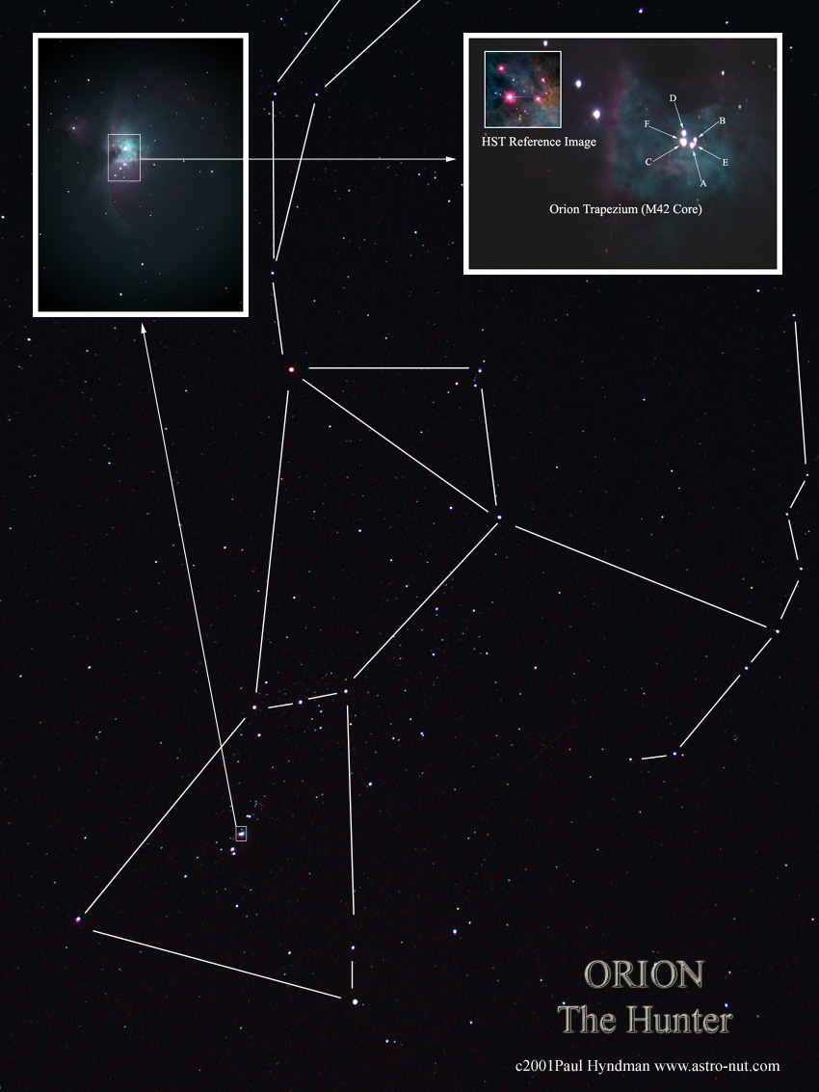

Slide 15
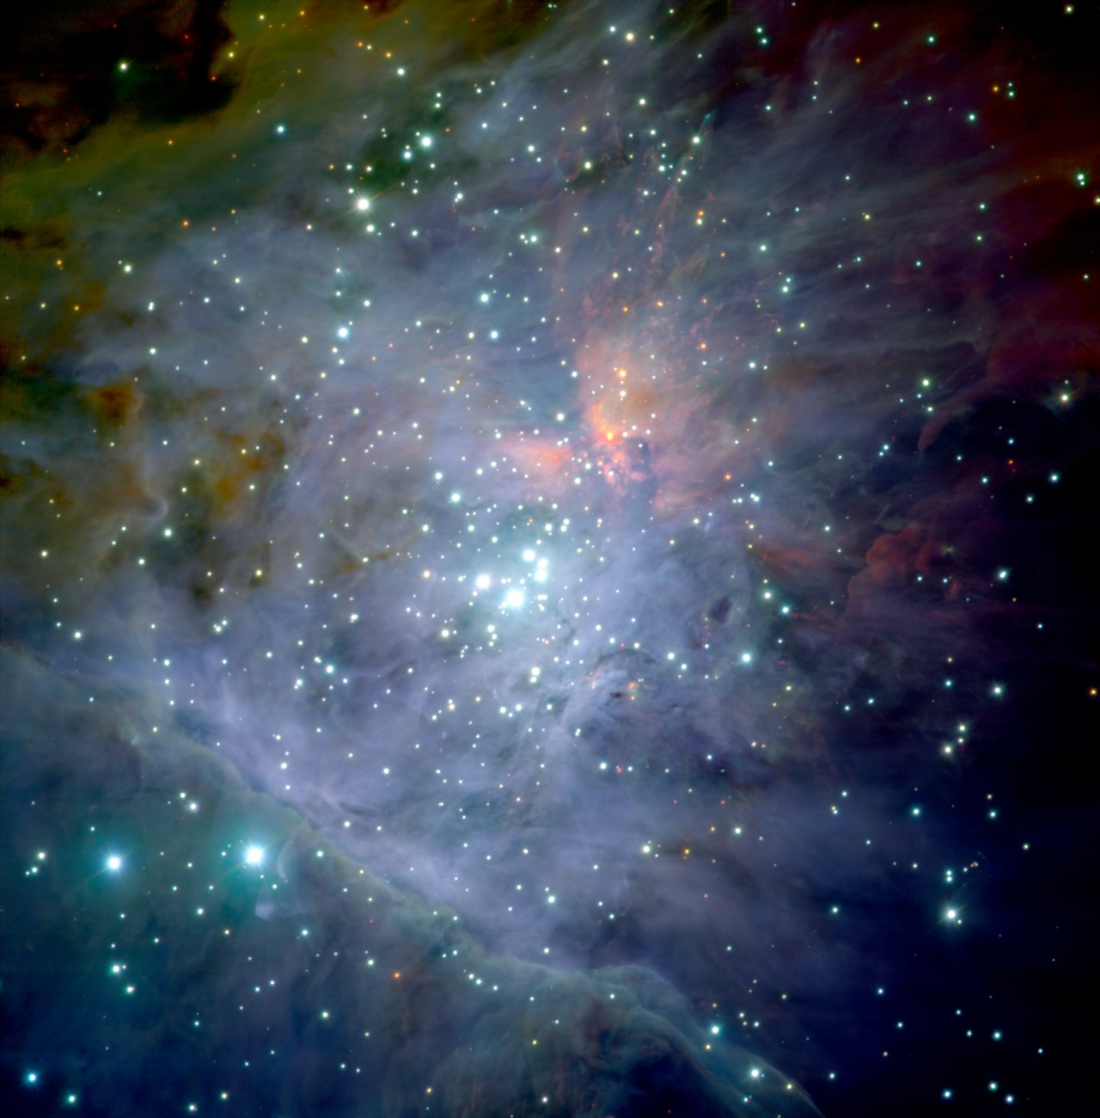
Orion Nebula
The closest star-forming region to Earth.
The youngest & brightest stars in the Orion Nebula are thought to be less than 100,000 years old.
These young stars are especially massive and emit large quantities of ionizing UV radiation.

Slide 16
Orion Nebula
Within this nebula, there are about 700 stars in various stages of formation.
Among these young, unstable stars, there are at least 150 protoplanetary disks.

Slide 17
Orion Nebula
Each time a new star is formed, it creates stellar shockwaves that stir up the remaining gas causing other stars to be formed.
Eventually, most of the gas & dust will either be gathered into stars or ejected out. The remaining stars will form an open cluster, similar to Pleiades.

Slide 18
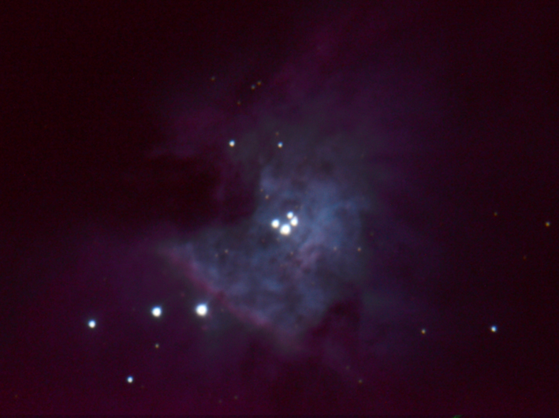
Orion Nebula Trapezium
The four Trapezium stars are probably the most recent stars formed in this area.
Trapezium
Two of the four Trapezium stars are really doubles, giving it 6 total stars.

Slide 19
Orion Nebula Trapezium
The four Trapezium stars are probably the most recent stars formed in this area.
Trapezium
Two of the four Trapezium stars are really doubles, giving it 6 total stars.

Slide 20


